Slide 1

MINI PROJECT BATCH-B72 CSE DEPARTMENT
FACIAL EMOTION RECOGNITION USING CONVOLUTIONAL NEURAL NETWORK
PRESENTED BY : UNDER THE GUIDANCE OF:
I.SUMANTH -19H51A05K4 R.SUHASINI

Slide 2
TABLE OF CONTENT:
ABSTRACT
INTRODUCTION
EXISTING SYSTEM
PROPOSED SYSTEM
SYSTEM REQUIREMENTS
METHODOLOGY
IMPLEMENTATION
ADVANTAGES
OUTPUT
CONCLUSION
REFERENCES

Slide 3
TABLE OF CONTENT:
ABSTRACT
INTRODUCTION
EXISTING SOLUTION
PROPOSED SYSTEM
SYSTEM REQUIREMENTS
METHODOLOGY
IMPLEMENTATION
CODE
OUTPUT
CONCLUSION
ADVANTAGES
REFERENCES

Slide 4
ABSTRACT:
Emotions analysis play an important role in modern life era. As in current situation we are unable to catch the student emotions in e-learning platform. Everything is going to be online because of Pandemic. So we came with the idea of facial emotion recognition system where we can recognize the students emotions in online platform during e-learning. The project comprises of four modules:
The first module deals with capturing the video and identifying the face in that video and analyzing the emotions in that face.
The second module deals with the emotion prediction in a single image.
The third module deals with predicting the emotions of different people, in a group image.
The fourth module deals with the gender prediction, in a single image as well as in a video captured image.

Slide 5
Introduction:
Facial expressions are the vital identifiers for human feelings, because it corresponds to the emotions. Most of the times (roughly in 55% cases) the facial expression is a nonverbal way of emotional expression, and it can be considered as concrete evidence to uncover the emotions of the students while e-learning platform. The current approaches primarily focus on facial investigation keeping background intact and hence built up a lot of unnecessary and misleading features that confuse CNN training process. The current manuscript focuses on five essential facial expression classes reported, which are anger, sad/unhappy, smiling/happy, feared, and surprised/astonished. The FERC algorithm presented in this manuscript aims for expressional examination and to characterize the given image into these five essential emotion classes.

Slide 6
EXISTING SYSTEM:
The authors proposed a system that identifies and monitors student’s emotion and gives feedback in real-time in order to improve the e-learning environment for a greater content delivery. The system uses moving pattern of eyes and head to deduce relevant information to understand students’ mood in an e-learning environment. Ayvaz developed a Facial Emotion Recognition System (FERS), which recognizes the emotional states and motivation of students in videoconference type e-learning. The system uses 4 machine learning algorithms (SVM, KNN, Random Forest and Classification & Regression Trees) and the best accuracy rates were obtained using KNN and SVM algorithms.
DISADVANTAGES:
No proper prediction of emotion.
No high accuracy.

Slide 7
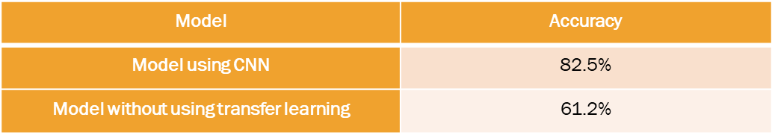
Proposed System:
Our proposed system to analyze students’ facial expressions using a Convolutional Neural Network (CNN) architecture. First, the system detects the face from input image and these detected faces are cropped and normalized to a size of 48×48. Then, these face images are used as input to CNN. Finally, the output is the facial expression recognition results (anger, happiness, sadness, disgust, surprise or neutral).

Slide 8
SYSTEM REQUIREMENTS :
HARDWARE REQUIREMENTS:
PROCESSOR : DUAL CORE 2
RAM : 4GB DD RAM
HARD DISK : 250 GB
SOFTWARE REQUIREMENTS:
OPERATING SYSTEM : WINDOWS 7/8/10
PLATFORM :VISUAL STUDIO CODE
PROGRAMMING LANGUAGE :PYTHON 3.7
FRONT END :VISUAL STUDIO CODE
PACKAGES : NUMPY,TENSOR FLOW,KERAS.

Slide 9
METHODOLGY:

Slide 10
Dataset:
The datasets is FER2013 download from kaggle
https://www.kaggle.com/deadskull7/fer2013
Where we use 7 emojis like angry, disgusted, fearful, happy, neutral, sad, surprised based on these emojis we recognize the facial emotion of student.
It contains 16900 images and for each class as below:
• Angry:4593 images
• Happy:8989 images
• Neural:6198 images
• Disgust:547 images
• Fear:5121 images
• Sad: 6077 Images
• Surprise: 4002 Images

Slide 11
IMPLEMENTATION:
In first step we collect number of datasets with different number of images. The dataset used is FER2013 which consists of 35887 of seven sorts of emotional classes.
After collecting dataset load the model into platform and perform the preprocessing steps for image. The large dataset in divided into test and train , validate the test sets using the train and divide the images according to their category. CNN model build using tensor flow and keras. After building the model compile the model and accuracy is checked as metric to check either model is perfectly compiled or not . The classified images are accessed in test dataset and stored in .h5 file, load functions such as Open CV to capture and recognize the emotion using classified images in dataset. Thus , facial emotion is recognized.

Slide 12
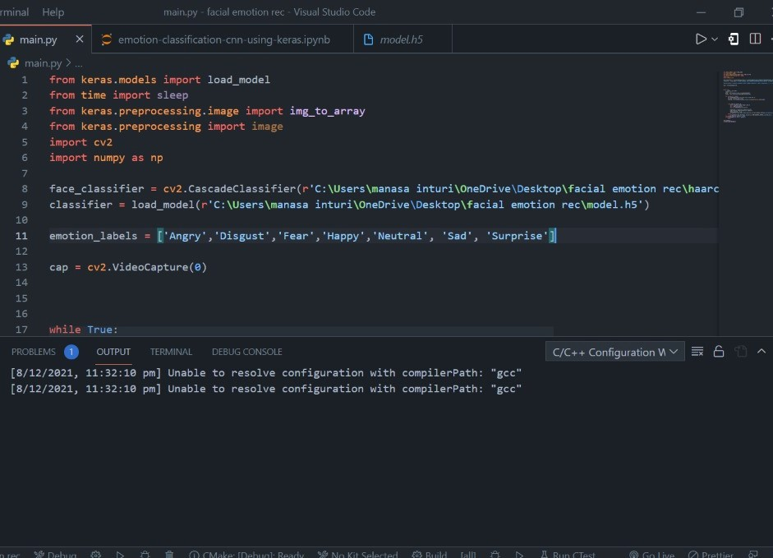
CODE:

Slide 13
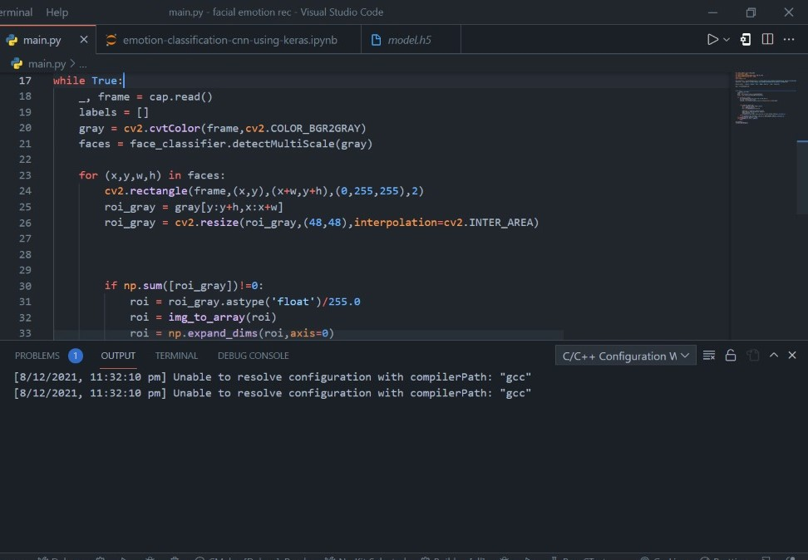

Slide 14
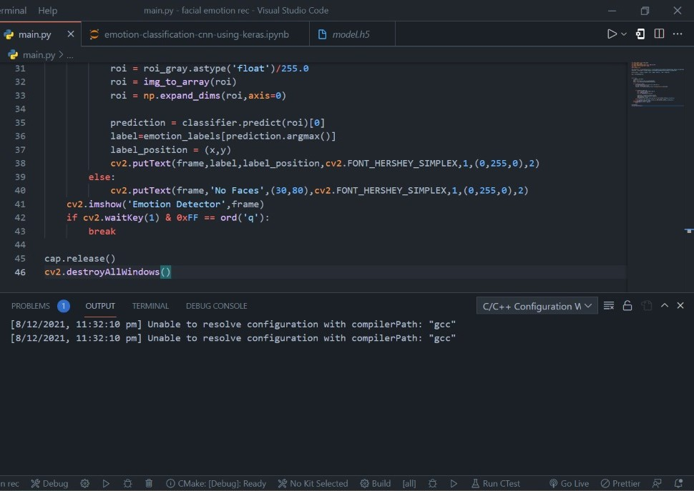

Slide 15
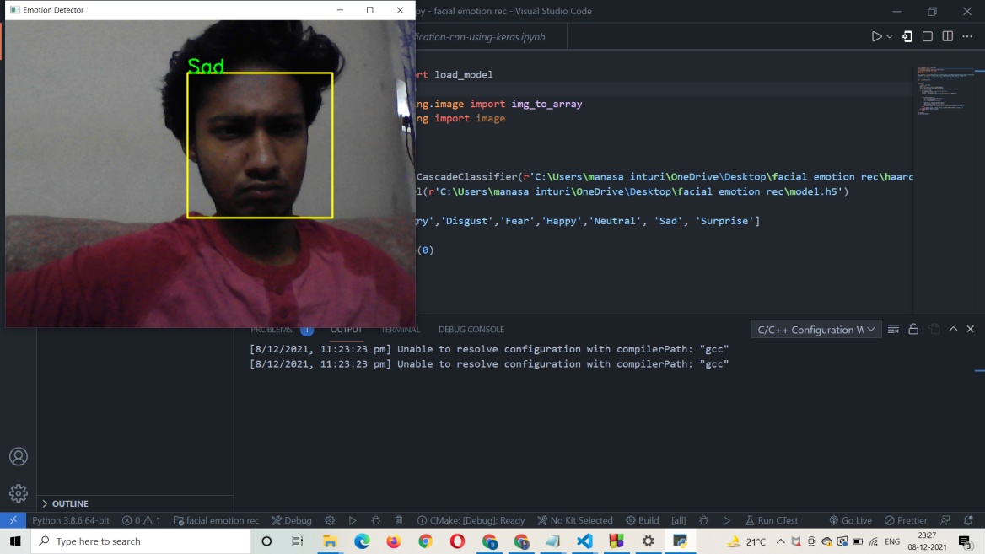
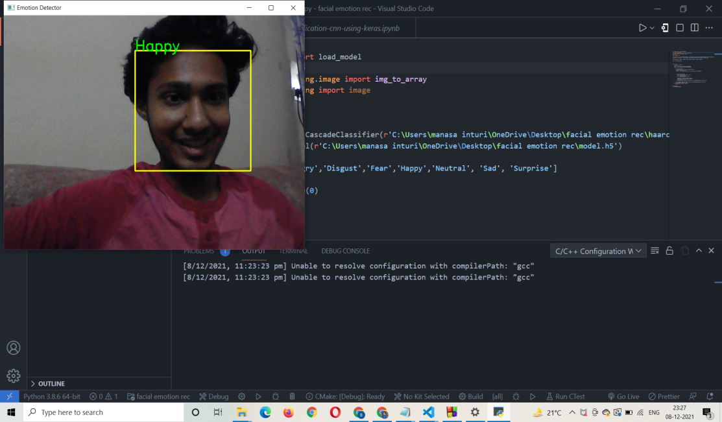
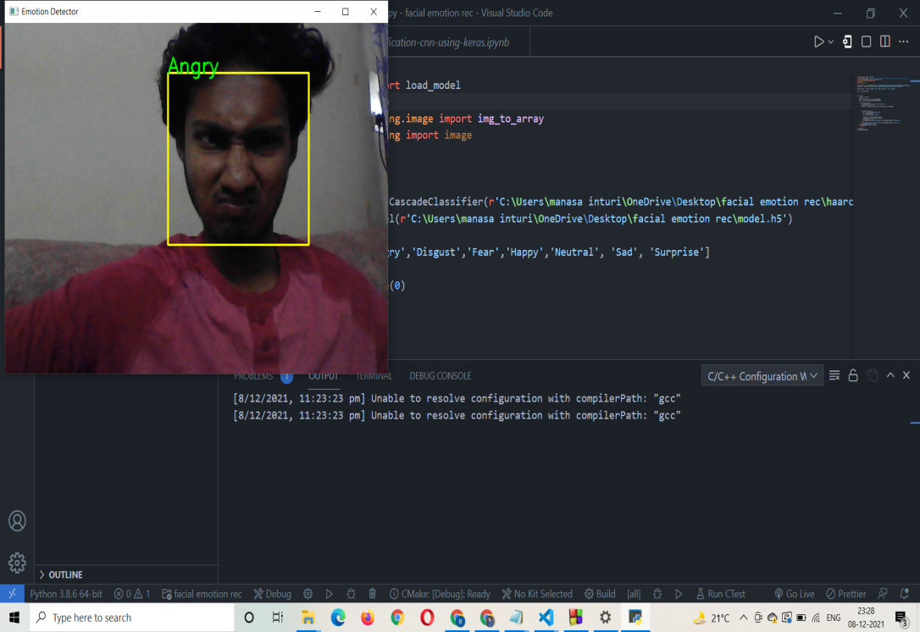
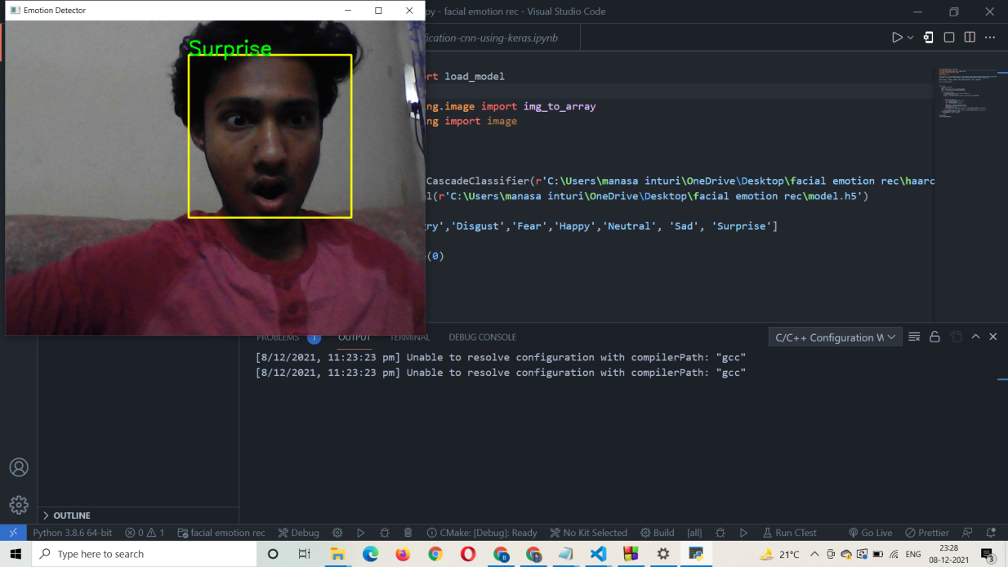
OUTPUT:

Slide 16
Conclusion:
In the paper we proposed deep learning Convolution neural network architecture with training on 32298 images of emotions and testing on 3589 images of emotions and correctly classifies 82.5% from the proposed model in the paper we are able to say that CNN algorithms are producing good results for image dataset.The proposed method can directly takes image values as input through training sample image data. The proposed method can automatically learn pattern features through CNN and reduce the incompleteness effected by artificial design features. By improving the training images we achieve better results.
ADVANTAGES:
This algorithm can improve the recognition rate of student facial expressions in complex background also.
The face emotion detection and prediction is high accurate

Slide 17
REFERENCES:
Albert Mehrabian. Silent Messages, University of California Los Angeles, 1971.
A Survey Paper on Facial Expression Recognition System, International Journal of Emerging Technologies and Innovative Research (www.jetir.org | UGC and issn Approved), ISSN: 2349-5162, Vol.3, Issue 2, page no. pp44-46, February-2016.
Very deep convolution networks for large-scale image recognition. Visual Geometry Group, Department of Engineering Science, University of Oxford, 2015.
Yaniv Taigman, Ming Yang, Marc'Aurelio Ranzato, Lior Wolf. DeepFace: Closing the Gap to Human-Level Performance in Face Verification. The IEEE Conference on Computer Vision and Pattern Recognition (CVPR), 2014, pp.1701-1708.

Slide 18


